Slide 1
Arranging Your Decor

Slide 2
What do you think?
Activity
On a sheet of paper, number 1-8.
With a partner, walk around the room and evaluate the photos of differently decorated room.
Write down your opinion of how each room is decorated. Is it good/bad? Why? What does it make you feel?

Slide 3
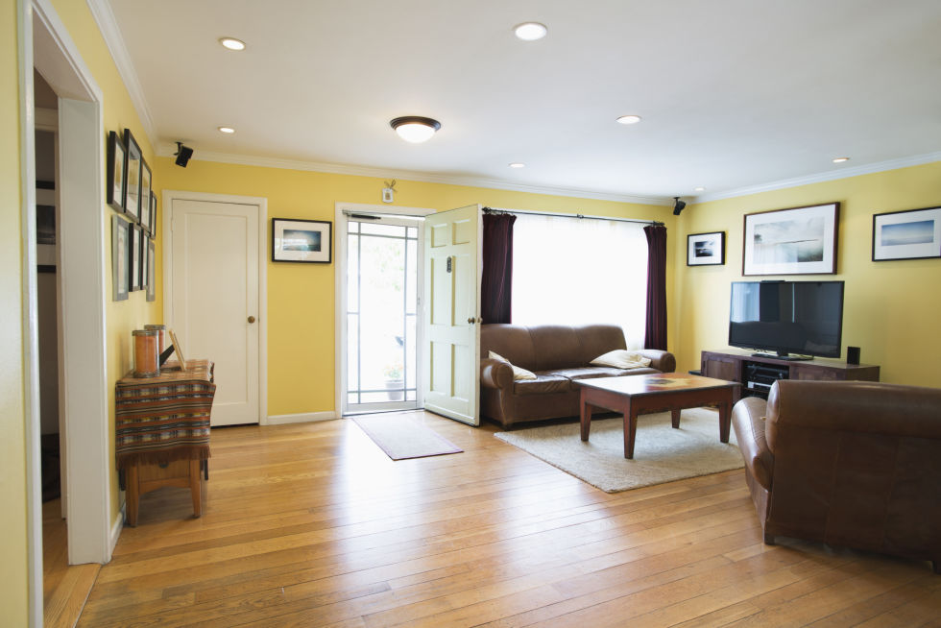
1

Slide 4
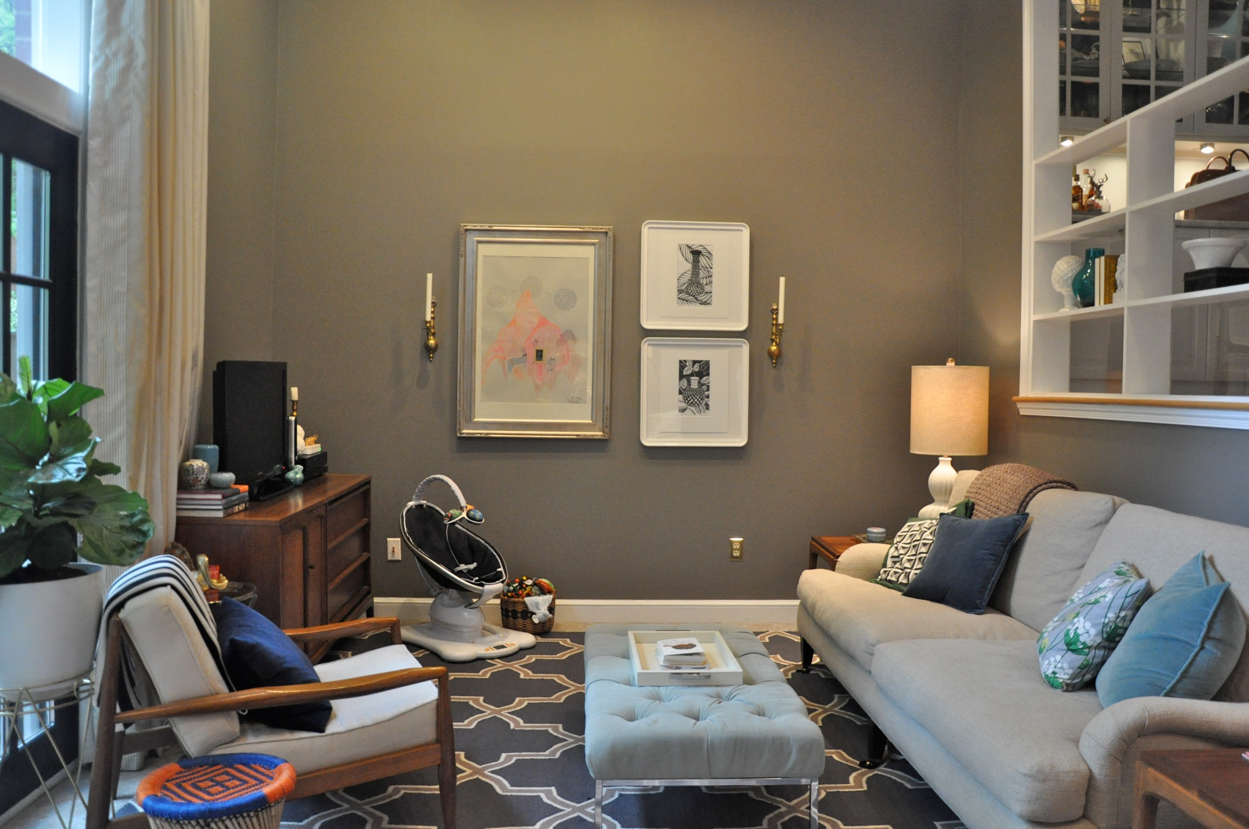
2

Slide 5
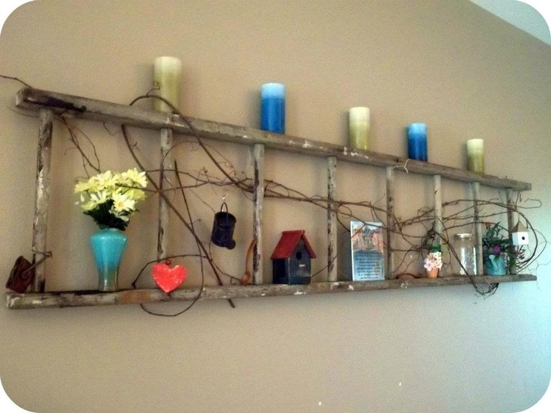
3

Slide 6
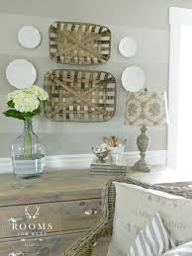
4

Slide 7
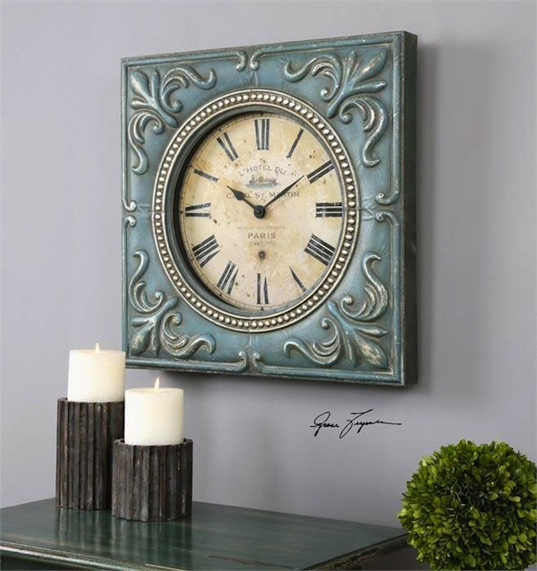
5

Slide 8
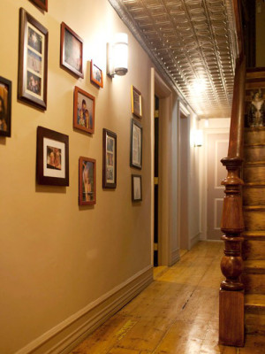
6

Slide 9
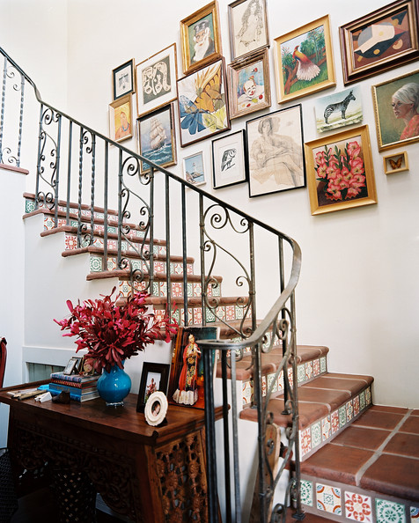
7

Slide 10
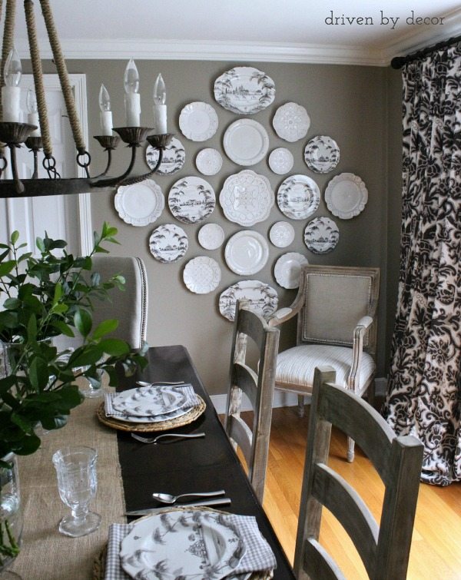
8

Slide 11
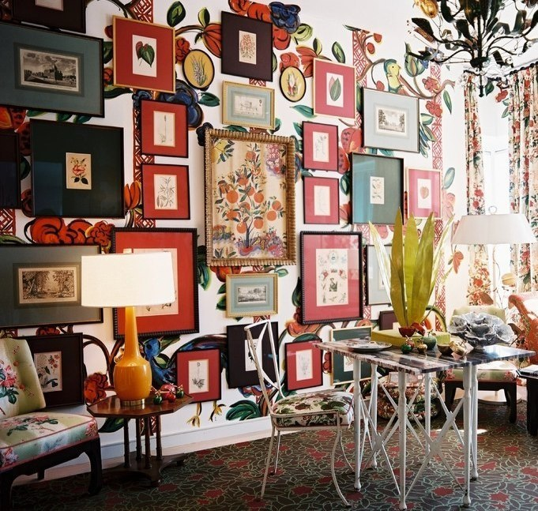
9

Slide 12
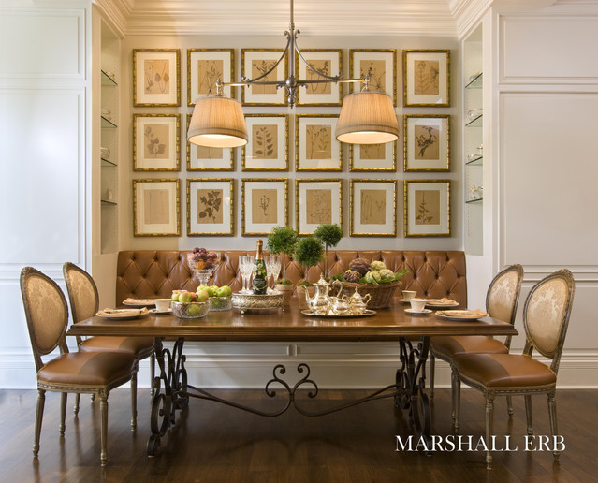
10

Slide 13
15 Home Décor Trends for 2016
Elle Décor

