Slide 1
Final Design Project
Information:
Thursday, April 11
Seniors Present:
Wednesday, May 15
Thursday, May 16

Slide 2
Backgrounds
Floors, Walls, Ceilings, Windows

Slide 3
Backgrounds
Easy to overlook
Missing or out of proportion→ noticeable
Decide on backgrounds before anything else
Set the mood
Affect sound
May be focal point
Don’t forget textiles!!
Carpet, furniture, pillows, curtains, etc.

Slide 4
Floors
Often the most expensive component of a design project.
Resilient flooring—flooring with a semi-hard surface that returns to its original shape after stress.
Vinyl
Plastic laminate
Asphalt, rubber, cork

Slide 5
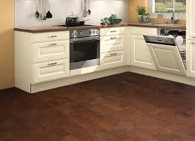
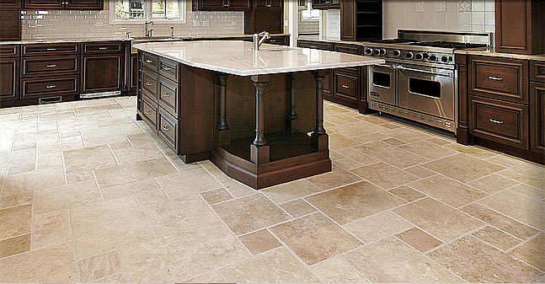
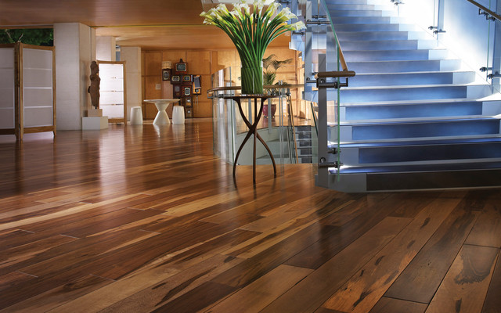
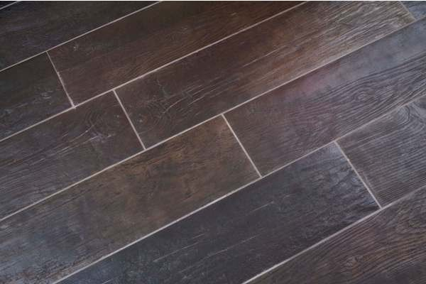
Tile
Cork
Hardwood
Tile that looks like wood

Slide 6
Floors
Carpet
Comfort
Cuts down on noise
Pile (or nap)—determines carpet quality
Sufficient enough to prevent crushing
Color and Pattern
Decorating scheme often centers around carpet
Repeat color/designs in wall and window treatments
Small pattern in small rooms; larger patterns in larger rooms
Rugs—carpet not attached to the floor
Generally oval or rectangle
Many sizes

Slide 7
How much do I need?
Often measured in square feet (sq. ft.)
Find the area of the space you are decorating
Length x Width
Determine how much/how many boxes
Be sure to do math
Divide the price by the number of boxes/amount you need to get the final price

Slide 8
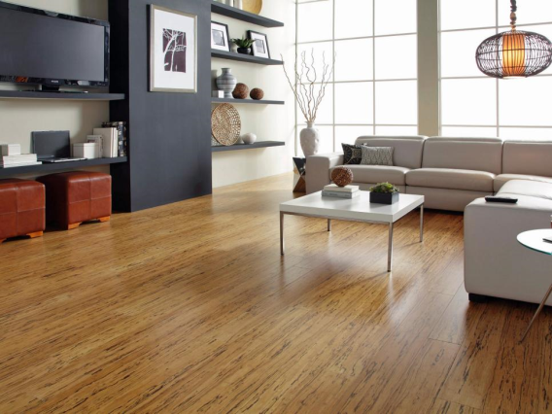
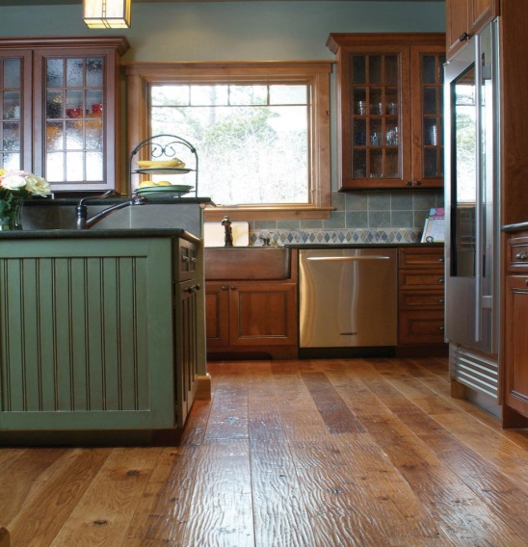
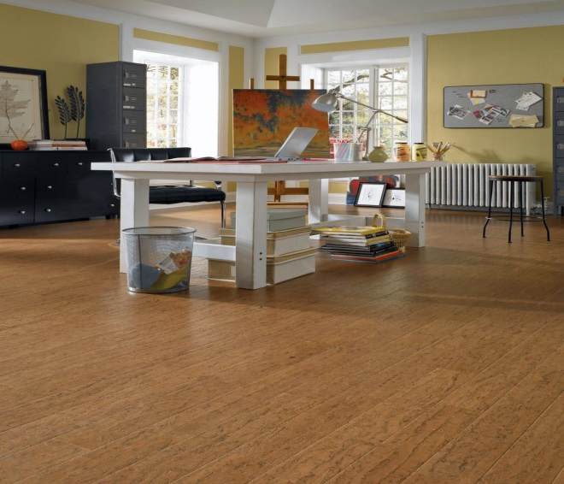
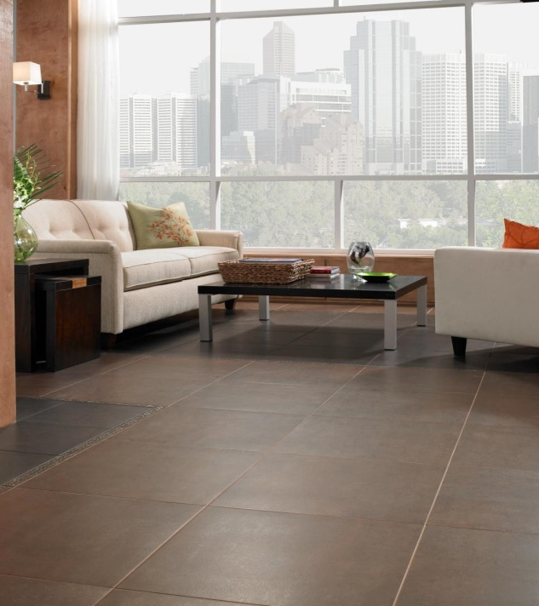
Flooring Trends
Bamboo
Reclaimed Wood
Cork
Large-Format Tile
HGTV

Slide 9
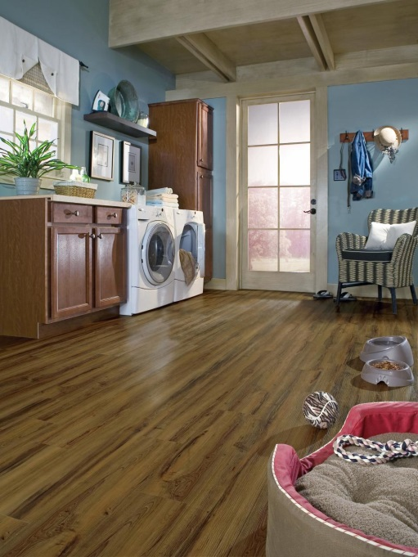
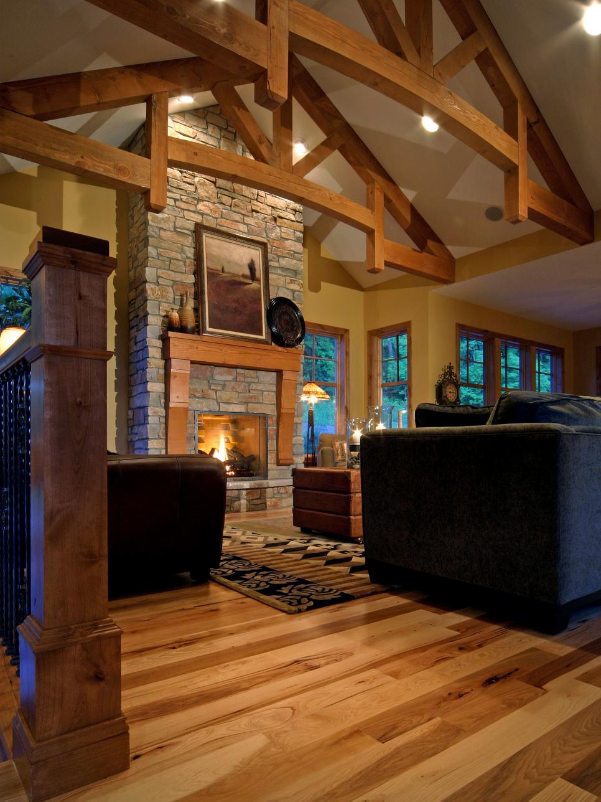
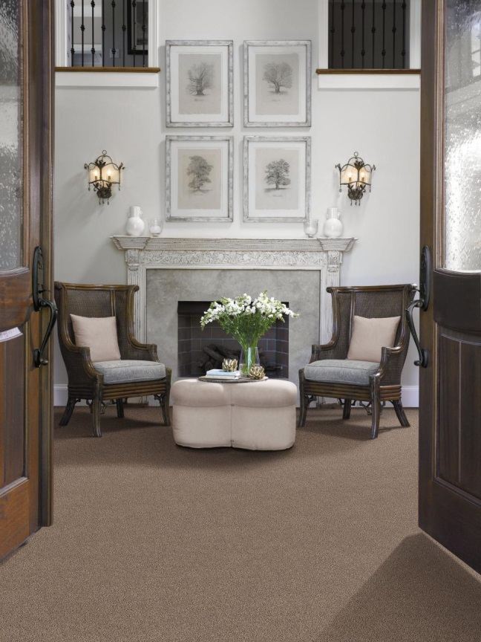
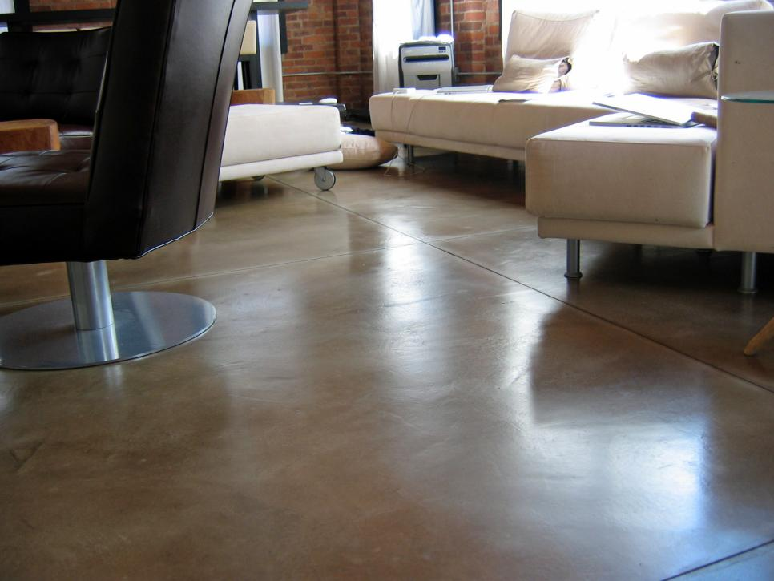
Luxury Vinyl
American Hardwood
Cut-and-Loop Carpet
Flooring Trends
Concrete
HGTV

Slide 10
Walls
Largest background space in a room
Most common wall coverings:
Paint (least expensive)
Wallpaper (easily covers cracks in walls)
Paneling (easily covers cracks in walls)
Other: fabric, mirrors, cork, carpeting
Walls are often NEUTRAL colors
Easily washable
Bathroom, kitchen, kids’ rooms, hall

Slide 11
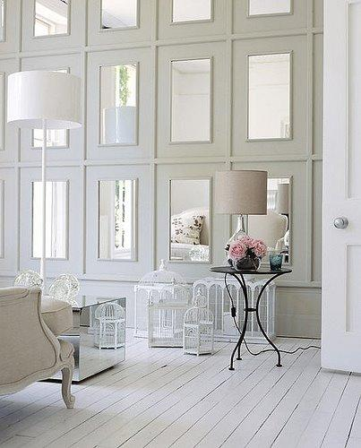
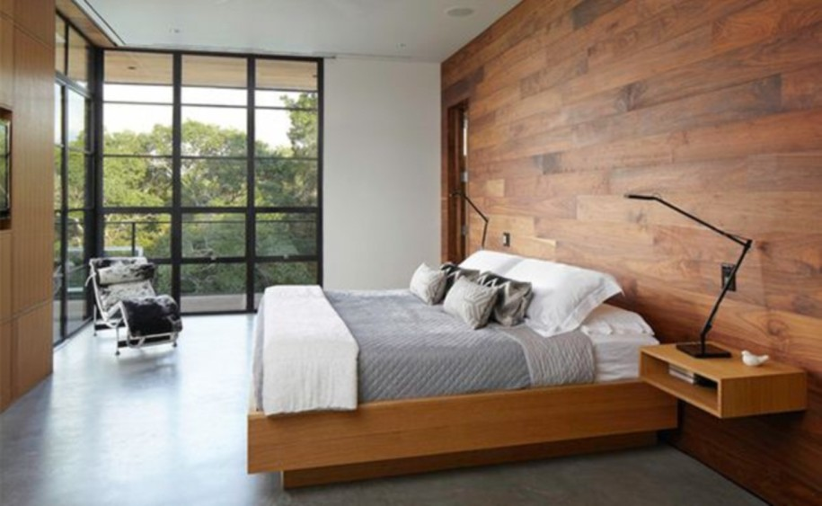
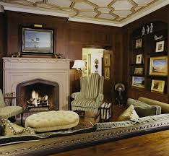
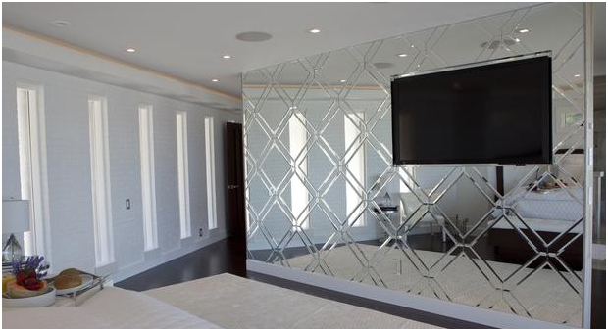

Slide 12
Walls
Wallpaper
Many designs
Wallpaper borders (relatively inexpensive)
Over paint or coordinate with wallpaper
Paneling
Camouflage imperfect walls
Solid wood, manufactured, laminate
Moldings—strips of shaped wood used for trim or ornamentation in a room
Finish a window, door, or wall (ceiling)
Chair rail—runs horizontally around the room about 3 ft. above the floor

Slide 13
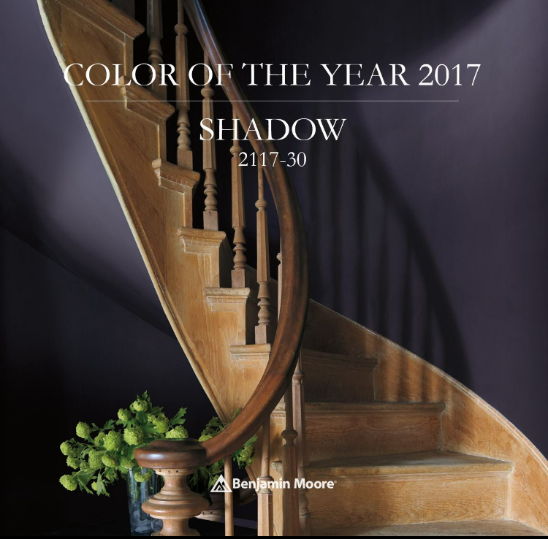
Current Wall Trends
Neutral Color Trend 2017
Poised Taupe
Color of the Year 2018
Caliente

Slide 14
How much do I need?
Find the area of each wall you are painting
Length x width
Add up the areas of all of the walls to find the total amount of space you are painting
One gallon usually covers about 250-400 sq. ft. (USE 350 sq. ft.)
So, 1 gallon of paint covers 350 sq. ft. of wall space

Slide 15
Ceilings
Most common = 8 ft.
Newer builds often have 9 ft. ceilings on 1st floor
Higher
Dignity, freedom
Vertical lines
Extend paint onto ceiling
Lower
Warm, informal
Border around top of wall
Ceiling color extended down onto wall
Other (more $$)
Beams
Coffered

Slide 16
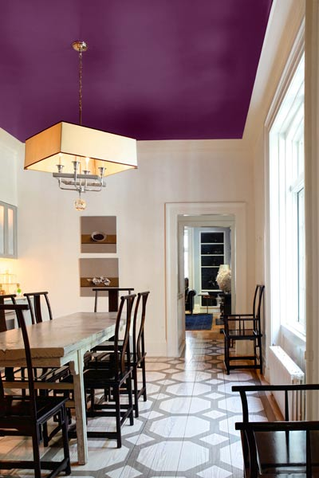
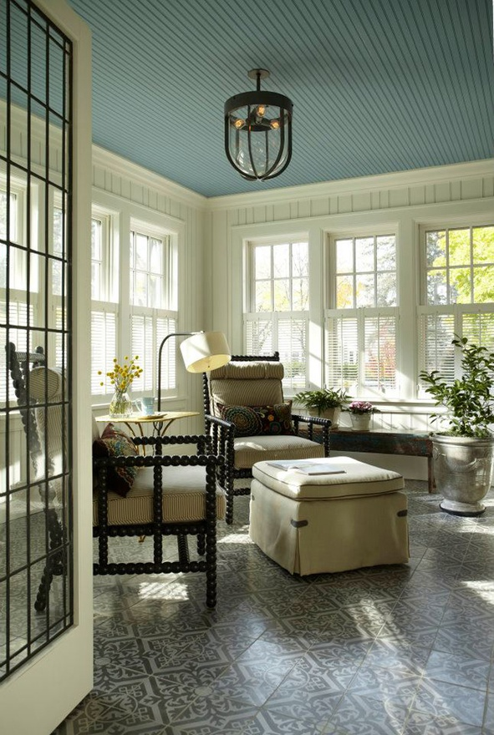

Slide 17
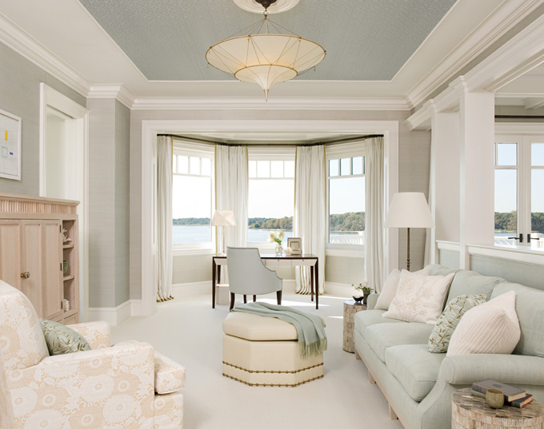
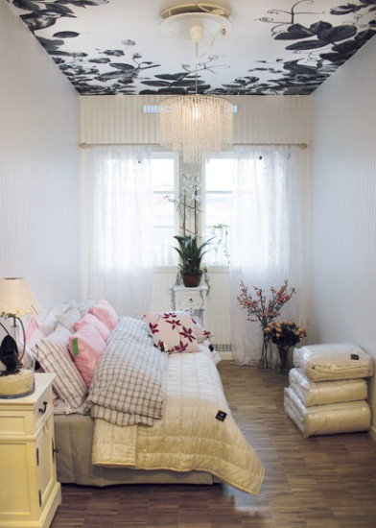
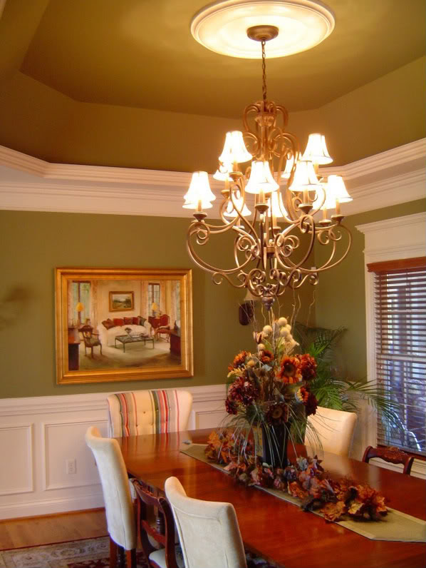

Slide 18
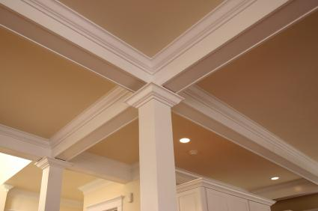
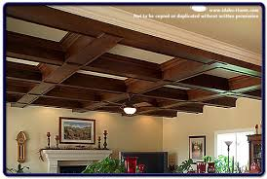
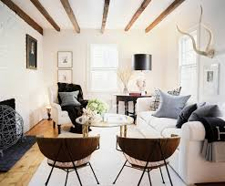
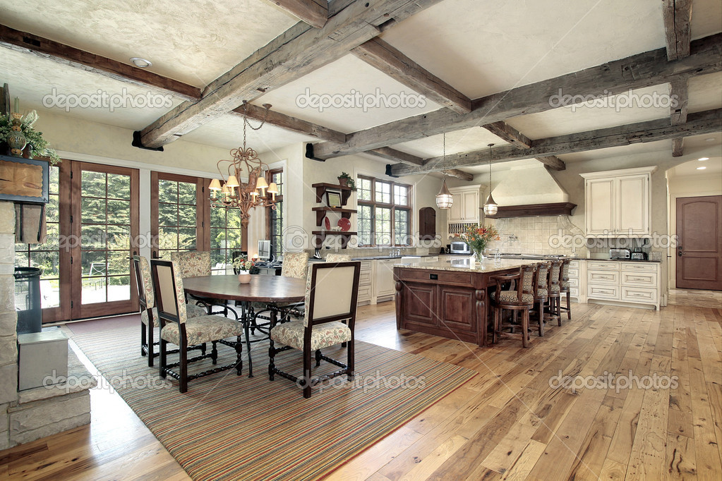

Slide 20
Window Coverings
Curtains
Drapes
Top Treatments
Valance
Swag
Window Hardware
Rods, tie backs, brackets, sconces, swag holders
Shutters
Blinds
Shades

Slide 21
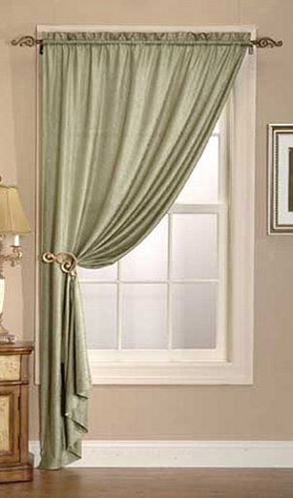
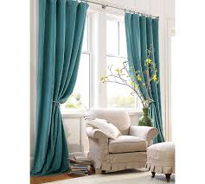
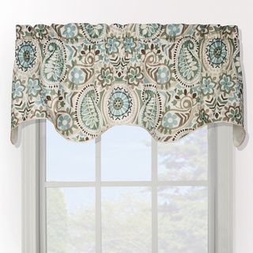
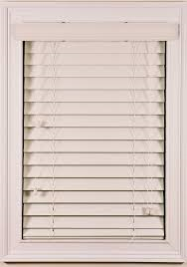
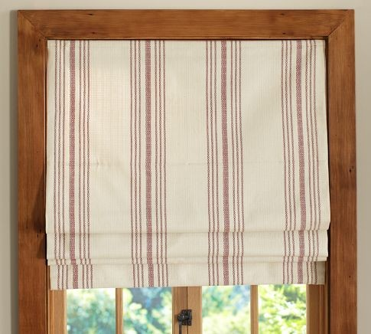
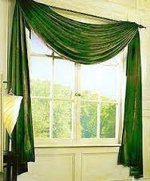
Drapes
Valance
Curtains
Blinds
Shades
Swag

Slide 22
15 Stylish Window Treatments
HGTV
10 Top Window Treatment Trends
HGTV 2014

Slide 23
Assignment
Get a textbook…
Using the book, start browsing ideas for your design project.
Record your ideas on the worksheet provided.
You have today and tomorrow to do this…
Computer Lab on Friday
G121

