Slide 1
Furniture
Interior
Design

Slide 2
Lots of Styles to Choose From!
Why do styles change?
Materials and manufacturing
Lifestyle changes
Changes in taste

Slide 3
Furniture Styles
Colonial Period, 1600—1780
William and Mary
Queen Anne
Chippendale
Postcolonial Period, 1780—1840
Federal
Empire
Shaker
Victorian Period, 1840—1900
Modern Period, 1901—Present
International
Contemporary
Styles often overlap

Slide 4
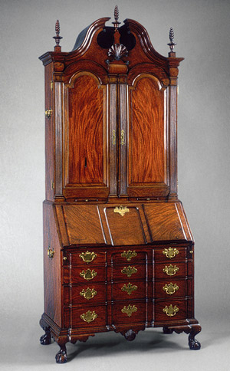
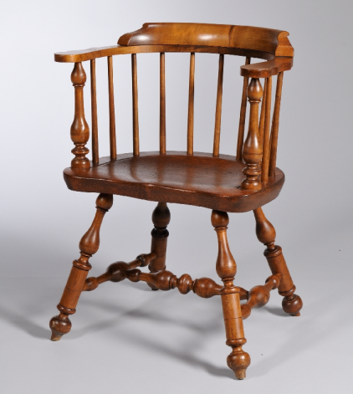
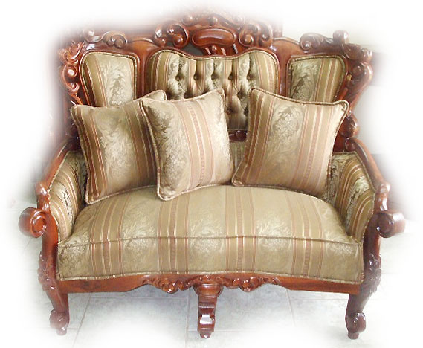
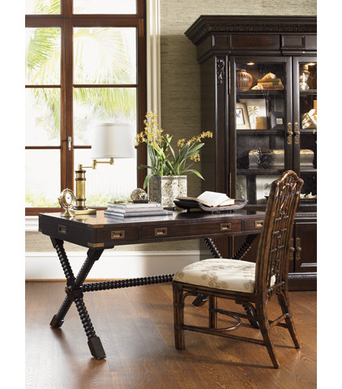
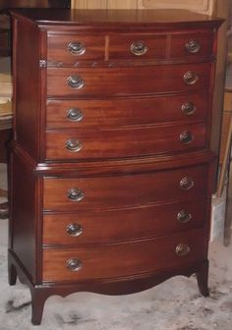
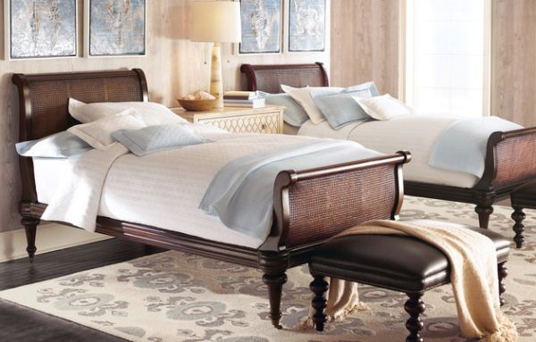
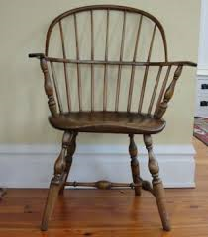
Furniture Styles—Colonial

Slide 5
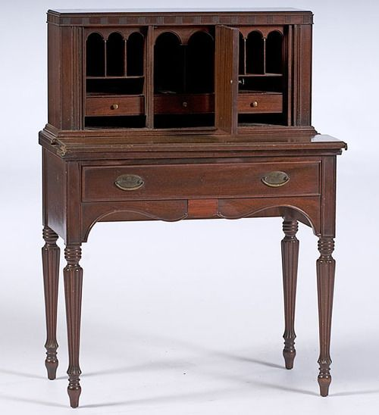
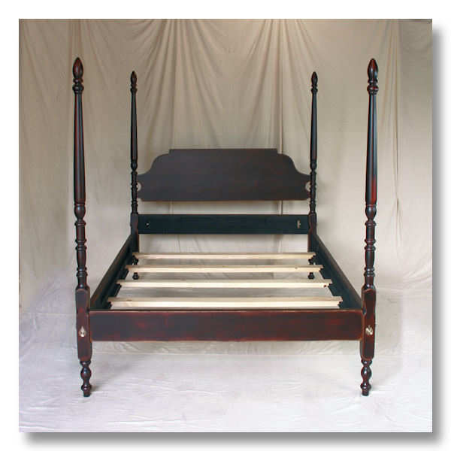
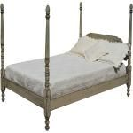
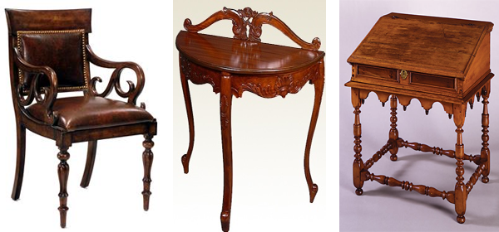
Furniture styles—postcolonial

Slide 6
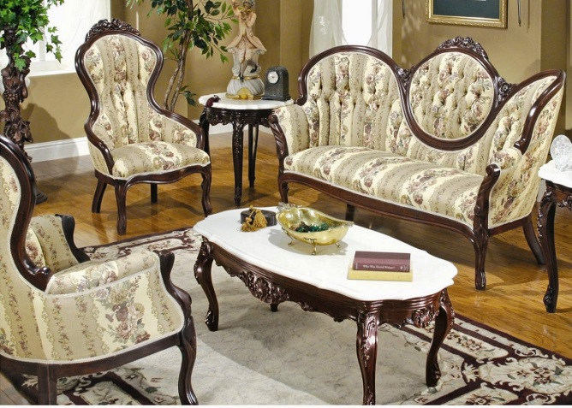
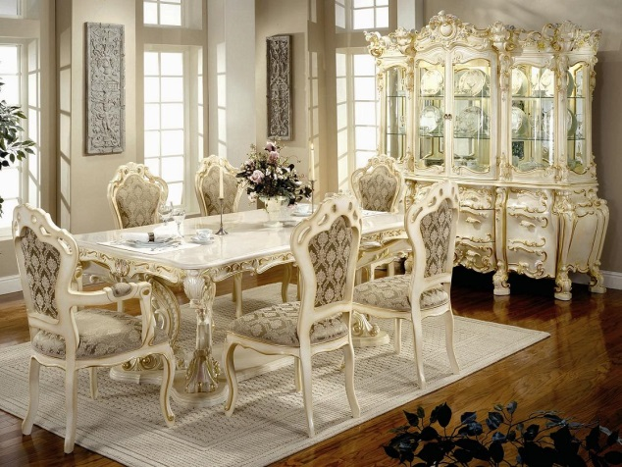
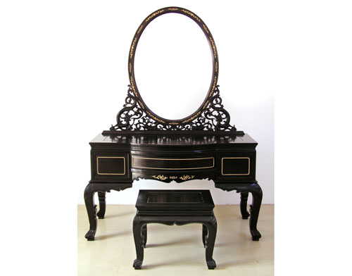
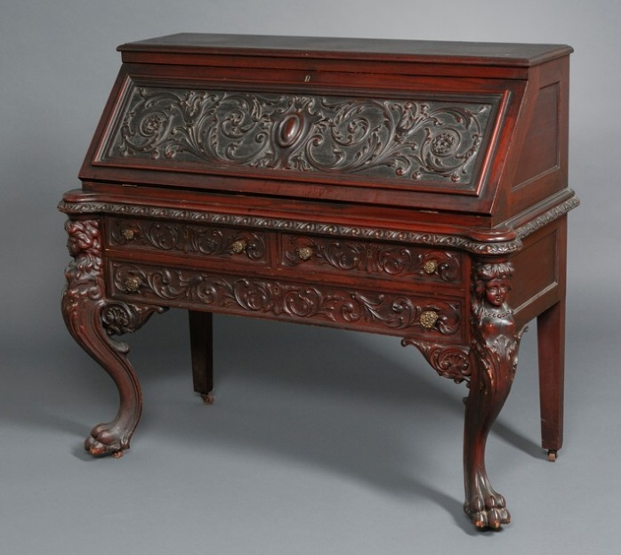
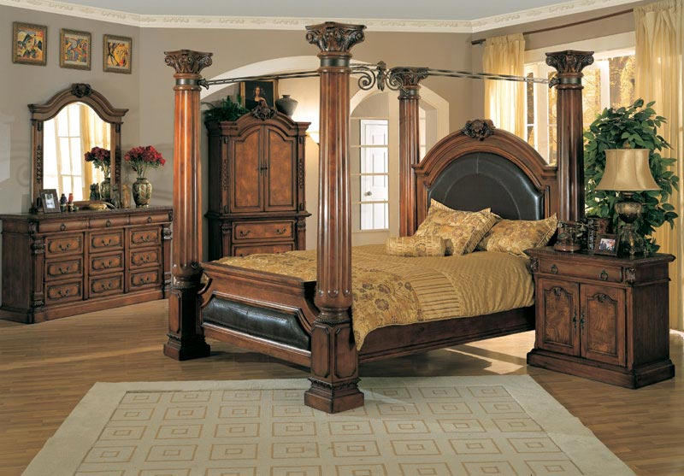
Furniture styles—victorian

Slide 7
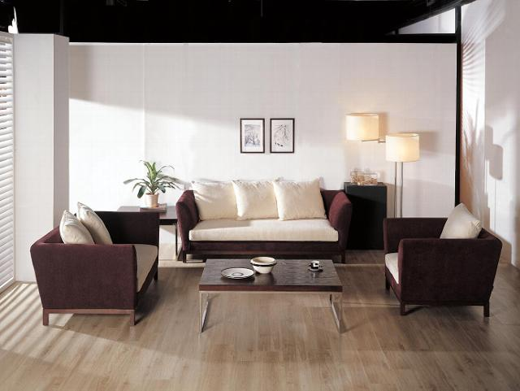
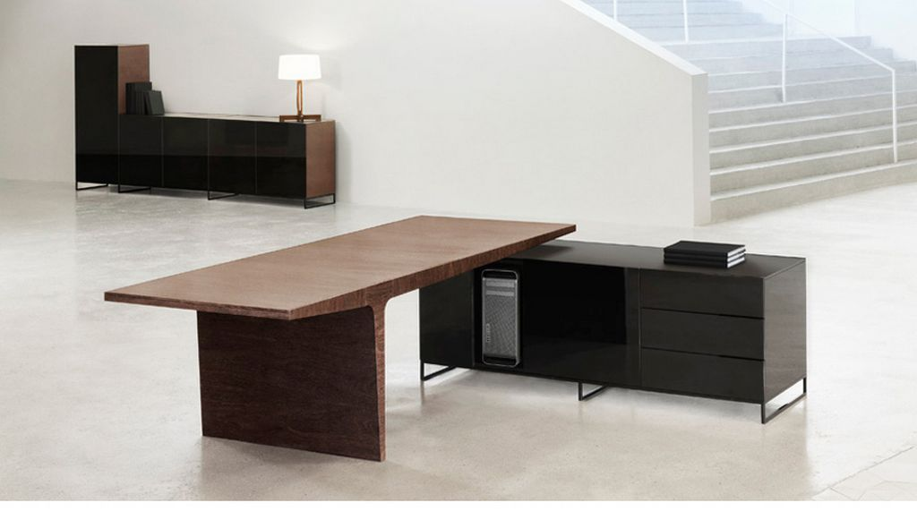
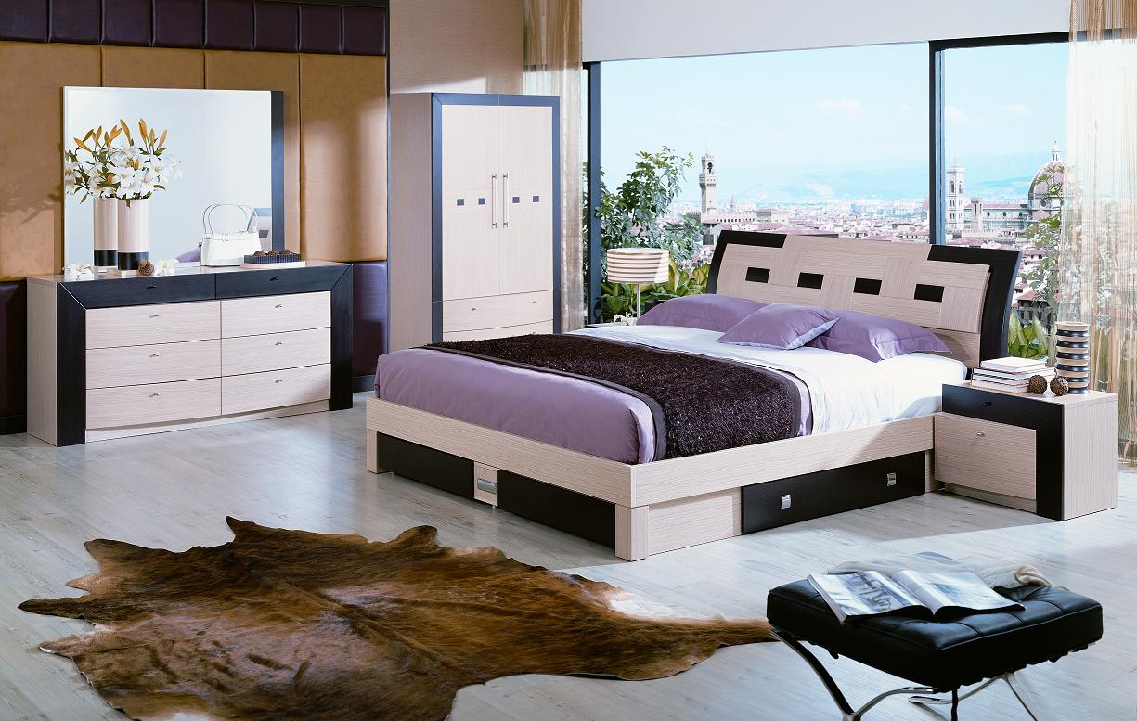
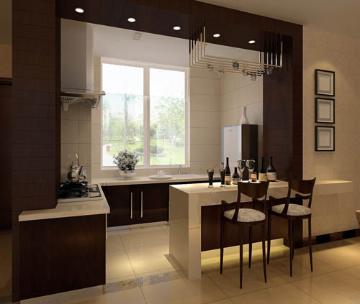
Furniture styles—modern

Slide 8
Selecting Furniture
Materials
Wood
Beautiful, durable
Hardwoods: cherry, maple, pecan, oak, walnut, mahogany, birch, ash
Expensive
Softwoods: pine, fir, redwood, cedar
Less expensive
Solid wood furniture—made of whole pieces of the same wood
Advantages: can be sanded and refinished, good quality
Disadvantages: wood can crack, swell, and warp; high cost
Veneer—ornamental overlay placed over base material
Advantages: strong, resists shrinking and warping, economical
Particle board—wood shavings, veneer scraps, etc. glued and pressed together (often used on the hidden areas of furniture)
Advantages: inexpensive, most durable
Disadvantages: appearance

Slide 9
Selecting furniture
Metal
Common: iron, steel, aluminum, brass, copper
Advantages: strong, durable
Disadvantages: easy to spot poor quality and design flaws, difficult to repair
Glass
Often combined with wood or metal frame to secure it
Should be tempered—treated for safety and durability)
Plastic
Often molded to form shapes and surfaces
Available in a variety of colors
Can be made to look like other materials—wood, marble, etc.
Advantage: low cost
Disadvantage: become dull, lose color, difficult to repair

Slide 10
Basic Furniture Construction
Joints—places where one piece of wood is connected to another
Check to make sure they are tight and strong
Glued, nailed, reinforced
Staples do not provide enough support
Some molded metal and plastic furniture may not have joints
Finishes
Applied to protect wood from moisture, heat, warping, and abrasions
Enhance or change color; decorate
Minimum preparation = sanding
Check finish of metal furniture (for care and quality)
Upholstery—chairs and sofas with padding, springs, and cushions
Frame
Springs
Padding
Cushions
Fabric
Check for quality
More info on pages 468-472

Slide 11
Shopping for Furniture What do you think?
New
Quality, warrantied
Expensive
Used
Sometimes cheaper
Takes time, money, effort to alter
Unfinished
Less expensive, variety of styles
Needs to be finished, quality varies
Unassembled
Often less expensive, can be taken apart for storage or moving
Needs to be put together (time)

Slide 12
Caring for furniture
Take note of how to care for furniture when choosing it.
Wood, metal, glass, plastic, and upholstery all require careful treatment and regular maintenance
Case goods (furniture that is not upholstered)
Dust and soil can scratch → dust regularly, wax polish
Cuts → treat with wax sticks
Watermarks → polish with wax (best solution = prevention)
Upholstery
Fabrics fade in the sun → away from windows, close window covering
Dirt and soil can damage fabric →vacuum regularly

Slide 13
Where to shop…
More Known Stores
Local
Pottery Barn (kids, teen, baby)
Walter E. Smithe
Pier 1
Art Van
Ashley Furniture
Hobby Lobby
Value City Furniture
Big Lots
Target
Turk Furniture
Premier Furniture
Interior Express Outlet
Lots more to choose from!!

Slide 14
Sparkle Furniture ☺

Slide 15
Kendall Jenner’s Couch
“Bao Sofa”
$52,000
Materials: ~394 feet of stuffed velvet tubing woven together.
Interesting Fact: Took 4 people more than a week to hand-make the couch

Slide 16
VIdeos
Fancy Dorm Room
Ole Miss
Video: Furnishings & Decorating (skips)

Slide 17
Furniture assignment
Using the template provided, design 5 different chairs.
Please number each chair.
Provide the following information about each chair on a separate sheet:
Style
Materials used (wood, upholstery, etc.)

