Slide 1
Lighting & Accessories
Interior Design
Chapter 22
What type of light do you prefer?
Do you have a favorite type of light fixture? Is there something you really do not like?
What type of lighting options are you using in your design project?

Slide 2
Direct vs. Indirect Light
Direct
Light that shines on specific areas
Indirect
Reflected off ceilings and walls
More diffused, softer

Slide 3
Types of Lighting
General
a.k.a. background/ambient light
See everything in the room
Most effective—direct + indirect
Task
Focus on area of need (reading)
More intense
Shaped shades to direct light where needed
Accent
Light aimed directly on a specific object to create a dramatic effect
3 times brighter than general lighting

Slide 4
Structural vs. Nonstructural Lights
Structural
Nonstructural
Built-in lights
“Permanent”
Recessed lights (downlights)
Wall washers
Strip lights
Cornice lights
Soffit lights
Fixtures that can be moved or replaced
Ceiling and wall fixtures
Portable lamps

Slide 5
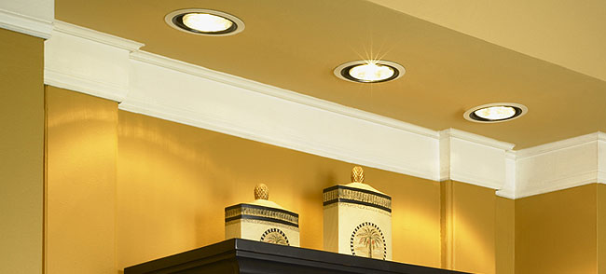
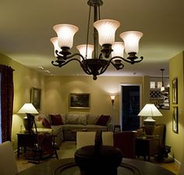
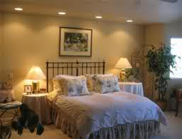
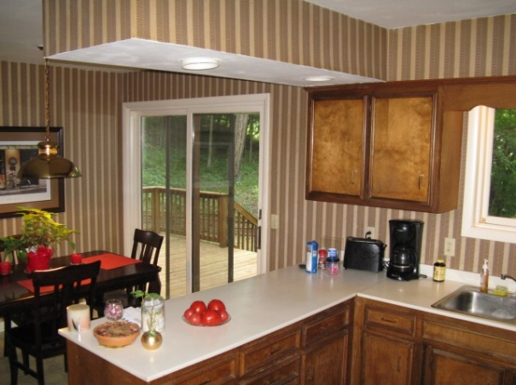
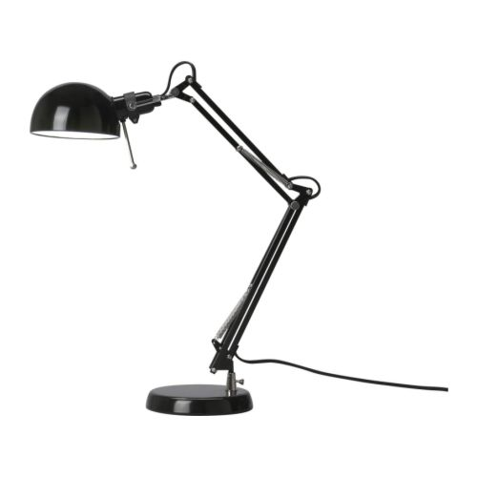
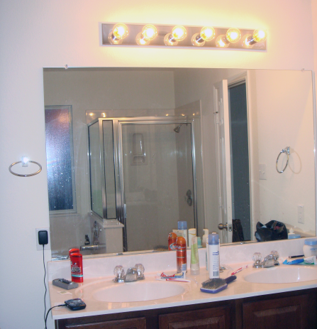
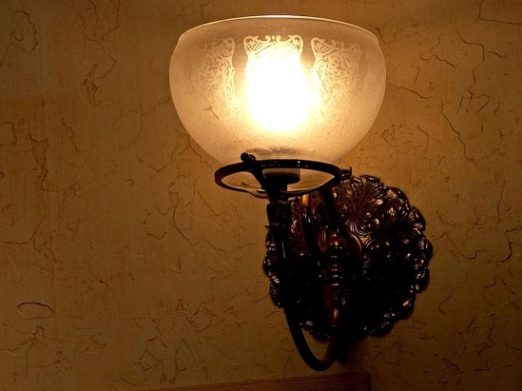
Structural vs. Nonstructural Lights
Structural
Nonstructural

Slide 6
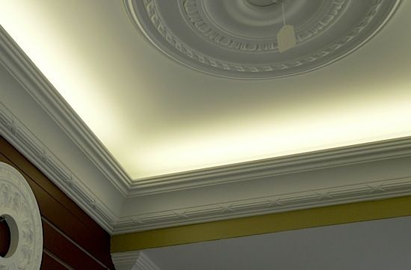
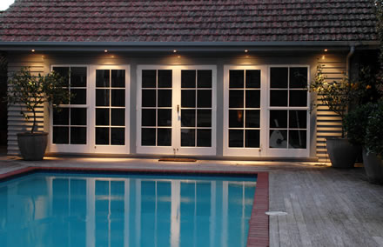
Cornice Lighting
Soffit Lighting

Slide 7
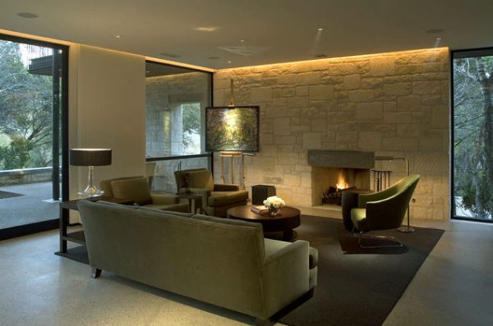
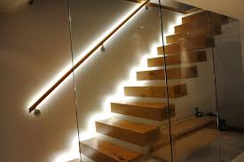
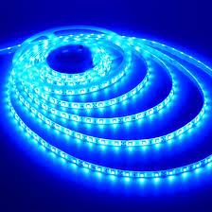
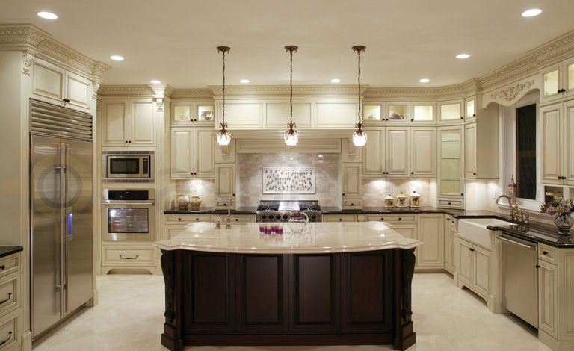
Wall Washer Lighting
Strip Lighting
Recessed Lighting
(pendant lighting)

Slide 8
Decorating with Light
Amount of light depends on purpose of the room
Smooth surfaces, light colors = reflect (appears to be more light)
Textured fabrics, dark colors = absorb (appears to be less light)
Use a combination of lighting to achieve the desired look
Structural, nonstructural
Downlighting, uplighting, wall-washing, accent

Slide 9
When to Use What
Entryway
Light, welcoming
Pendant
Hall
Spacious
Cove, bracket, accent
Stairs
Lit at top and bottom
Switches at both
Recessed downlights
Living/Family Room
Variety
General, dimmers
Task
Dining Room
Attractive AND functional
Chandelier, pendant, cornice
Kitchen
Plenty of light, avoid shadows
Large ceiling fixture
Soffit lighting, track lights
Bedroom
Overhead light (ceiling fan)
Bedside
Bathroom
Safety
Ceiling, recessed downlights
Strip lights above/around mirrors
**For safety: Lighting needs to be accessible
when a person first enters any room.

Slide 10
Accessories
SOOOOO MANY OPTIONS!!!
What type of accessories do you use at home?
What do you like? Not like?
What are you using for your design project?

Slide 11
Wall Decorations
Paintings
Posters
Tapestries
Prints
Sculptures
Wall mirrors
Wall clocks
Shelf with items
Surface of the wall
Wallpaper, borders, stenciling

Slide 12
Basic Principles for Planning Wall Decorations
Hang items eye level
Shelves and baskets high enough to avoid being bumped
Consider proportion between wall décor, wall and nearby furniture
Art should not be wider than furniture under it
No smaller than ½ the piece’s length
Highly patterned wall→ More simple wall décor
Art frames should complement décor and art
Position mirrors to create illusion and depth; reflect something pleasing
Ex. Opposite fireplace
Use light to enhance color and texture of wall decorations
Avoid glare
Hanging hardware should be appropriate for each piece

Slide 13
Additional Accessories
Often items that reflect your identity and interests.
Do NOT have to be expensive!!
Family photos, souvenirs
Candlesticks, bowls, baskets, vases
Rocks, branches
Sculpture
Stack of books
Plants
Mix and match
Group
Organize by pattern, color, scheme
Vary heights

Slide 14
Accessories for Nonresidential Spaces
Textured wall hangings
Paintings
Art posters
Sculptures
Fountains
Make sure accessories/décor match the feel the space is trying to convey

Slide 15
Arranging Your Decor

Slide 16
What do you think?
Activity
On a sheet of paper, number 1-8.
With a partner, walk around the room and evaluate the photos of differently decorated room.
Write down your opinion of how each room is decorated. Is it good/bad? Why? What does it make you feel?

Slide 17
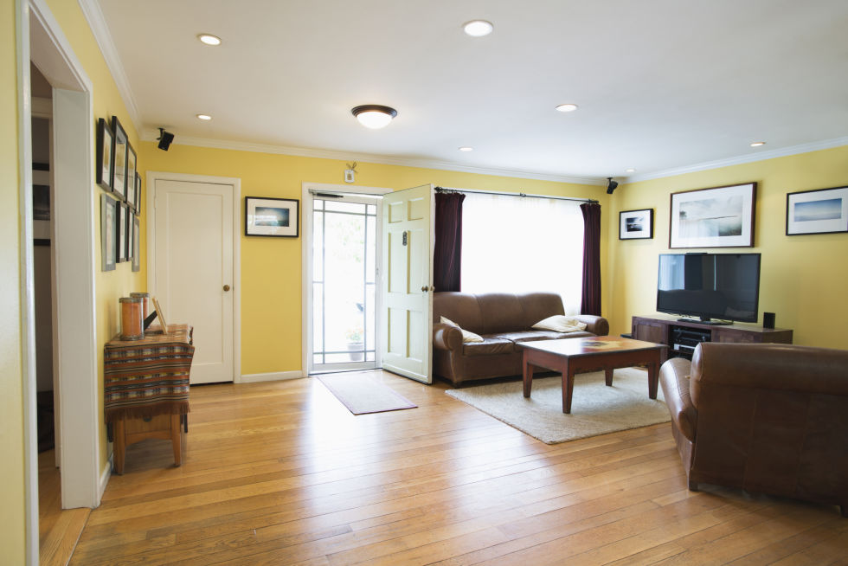
1

Slide 18
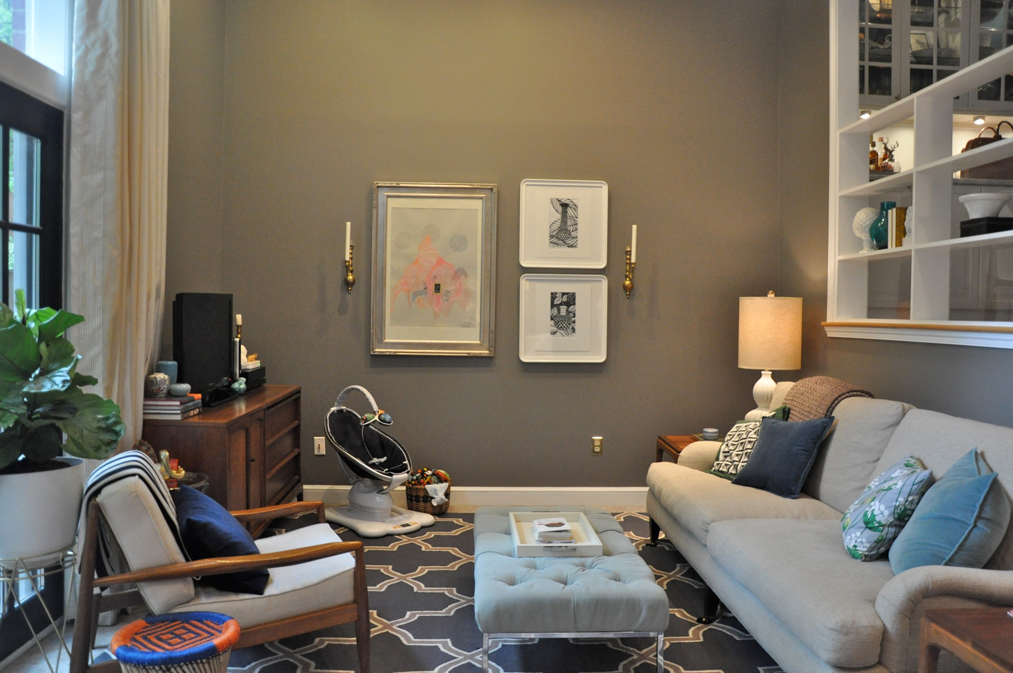
2

Slide 19
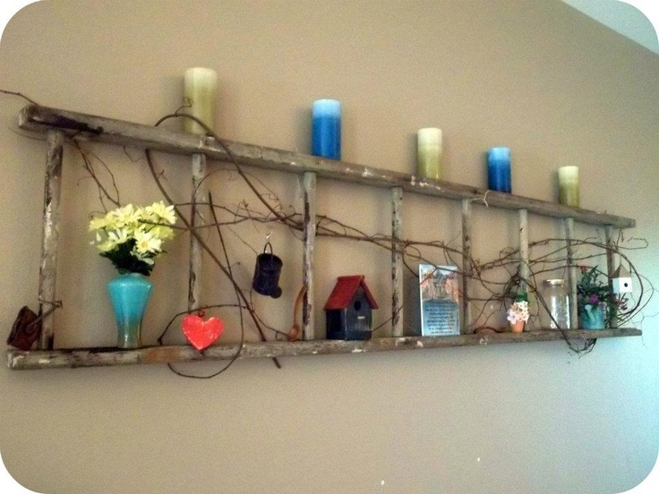
3

Slide 20
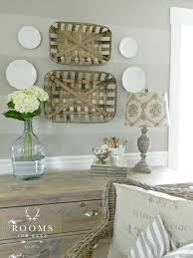
4

Slide 21
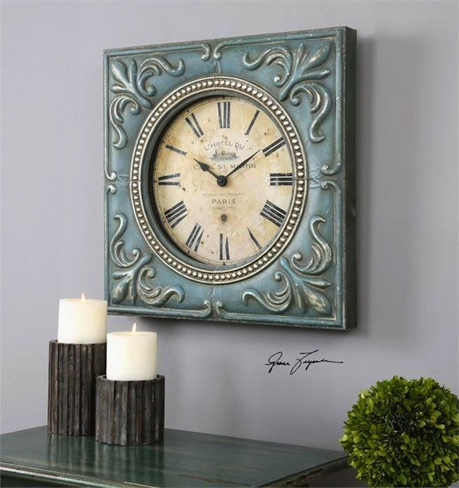
5

Slide 22
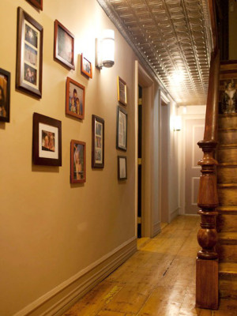
6

Slide 23
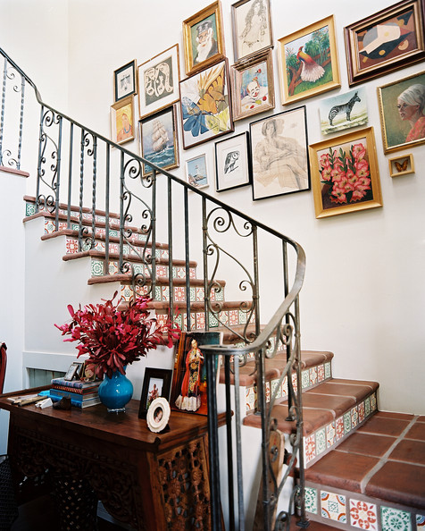
7

Slide 24
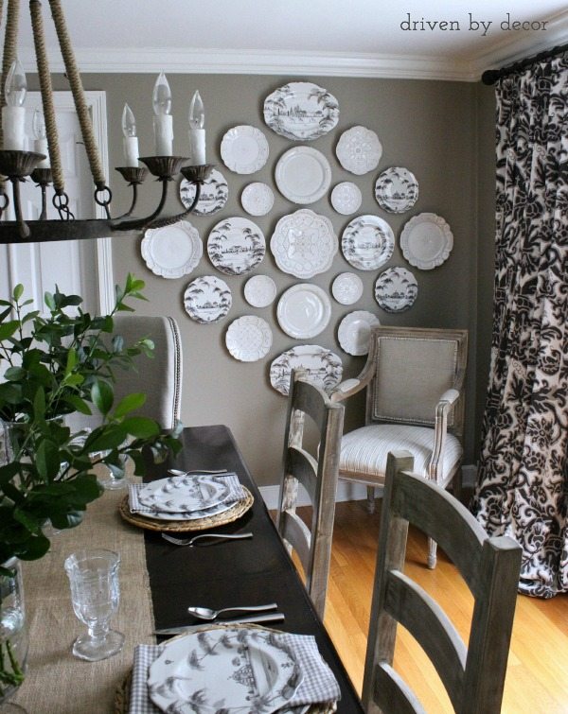
8

Slide 25
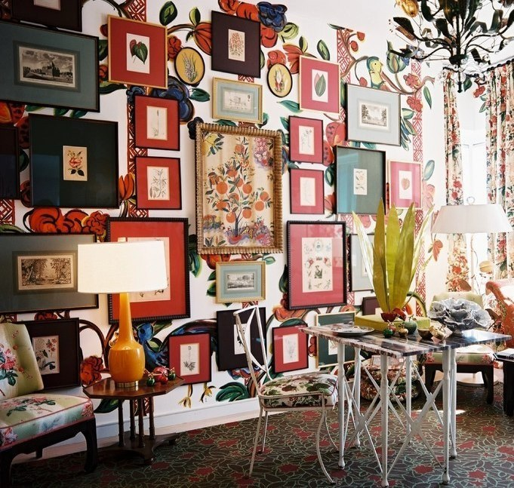
9

Slide 26
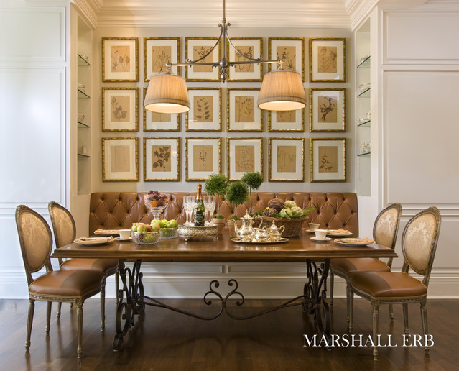
10

