Slide 1
Elements of Design
Space
Line
Texture
Form
Color

Slide 2
Principles of Design
Interior Design
Chapter 17

Slide 3
Proportion
Definition: the size relationships that can be found within an object or design
Often expressed as a ratio
2/1 or 2:1—something that is twice as long as it is wide
Certain proportions create more pleasing effects than others.
People often prefer rectangles over squares
BUT, too long of a rectangle = discomfort ☹
Unequal divisions of space are more appealing than equal divisions.

Slide 4
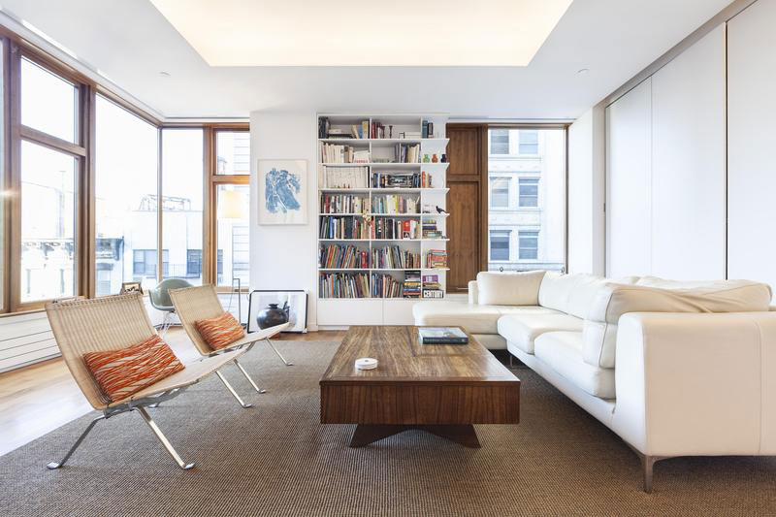
Proportion
The Golden Section
Greek
Dividing a line somewhere between 1/3 and ½ the distance from one end
Visually pleasing
Example:
Curtain tie-backs

Slide 5
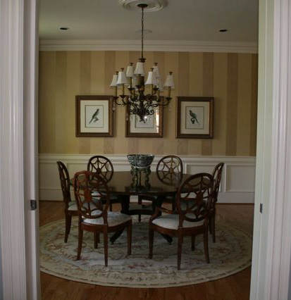
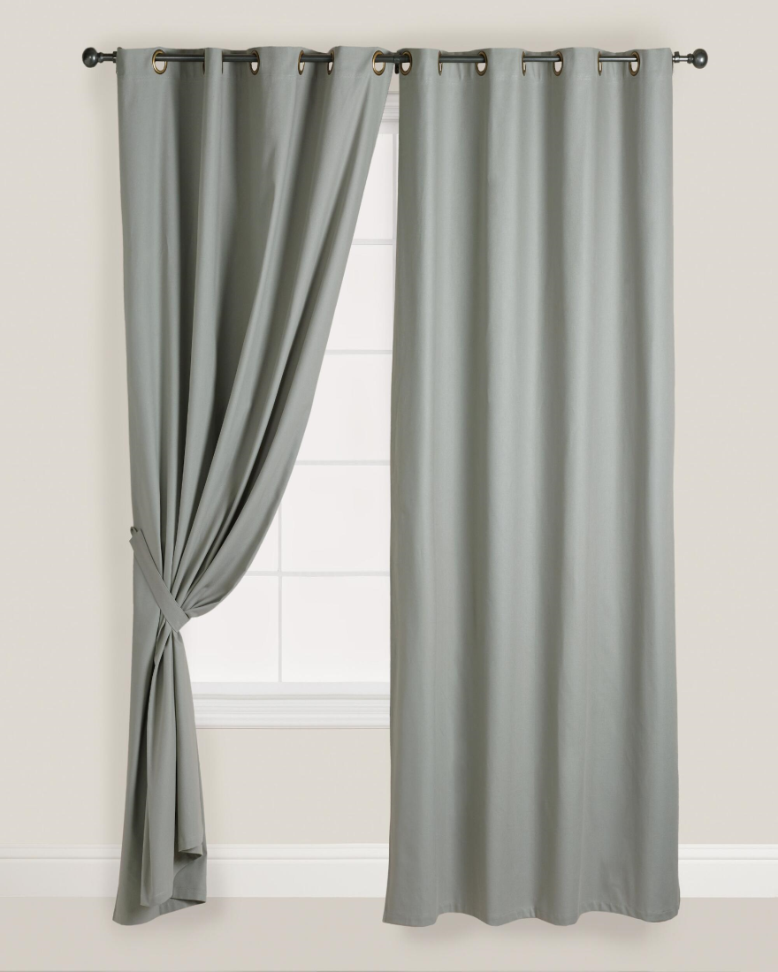
The Golden Section
Where is the Golden Section in each photo?

Slide 6
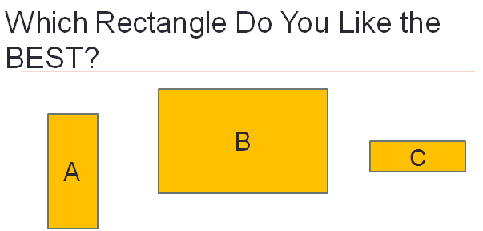
Did most of you say B?
Apparently this is not a coincidence, but that it is most appealing due to being a Golden Rectangle.

Slide 7
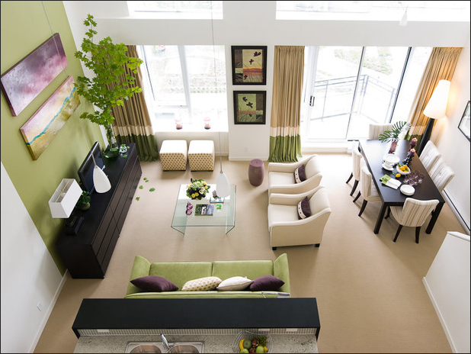
Proportion
The Golden Rectangle
Use Golden Section theory for length of lines
1: 1.618 “phi”
Most visually satisfying rectangle—not too skinny, not too square

Slide 8
Scale
Take a moment to read the following:
Imagine you’re sitting at a writing desk in a swivel chair. The chair is so large that your feet dangle, your knees bump the edge of the desk, and you have to hunch forward to write. When you get up to leave, you try to push the chair into the knee space of the desk, but it won’t fit.
What’s wrong?
The chair is too large for the desk—and for you.
The chair is out of scale.

Slide 9
Scale
Definition: how the size of an object relates to human beings and to other objects or spaces in a design.
Scale is NOT the same as proportion!
Ex. A lamp can be proportionate to itself, but must fit with the size of the other objects within a room/design.
Would an oversized coffee table and sofa fit the scale of a small den?? Why or why not?

Slide 10
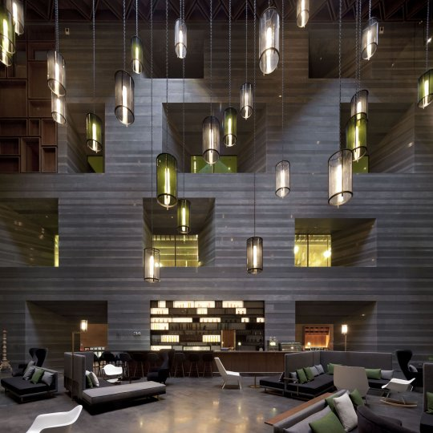
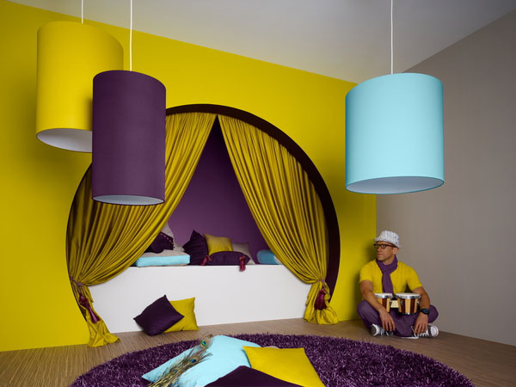
Scale
What do you think??

Slide 11
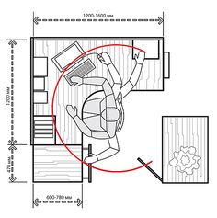
Scale
The Human Scale
Homes are built for humans
Use human figure to evaluate scale
Lack of appropriate scale can cause physical and visual discomfort.
Ex. Pictures and mirrors should be eye level.
Special considerations
Children’s rooms
Smaller furniture, lower shelves, etc.

Slide 12
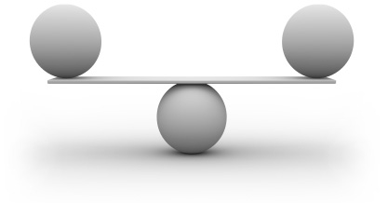
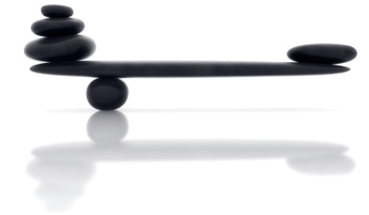
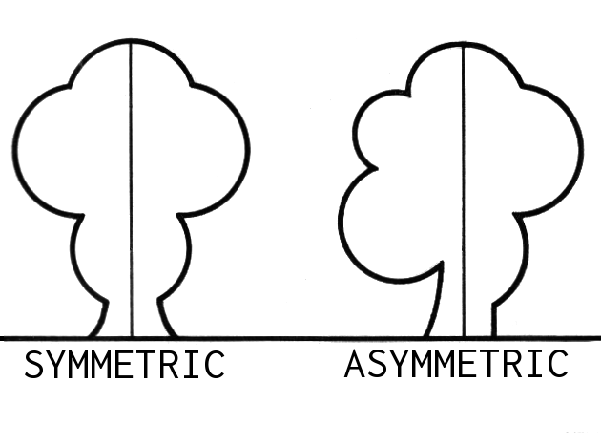
Balance
People feel the most content with a sense of order and balance.
Definition: the design principle that provides a feeling of equality.
Occurs when the amount, size, or weight of objects on both sides of a center point is equal, or when unequal objects or groups of objects appear to be equal.

Slide 13
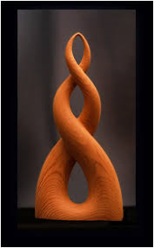
Symmetrical Balance
Definition: the arrangement of forms on one side of an imaginary central line is the mirror image of the forms on the opposite side.
Convey dignity, quiet
Feeling of rest and calm

Slide 14
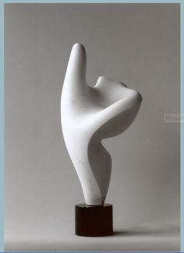
Asymmetrical Balance
Definition: design in which elements on either side of an imaginary central line are unmatched, but appear to be in balance.
A.K.A. informal balance
Common in East Asian design
Different sizes, forms, textures, and colors can be combined to achieve asymmetrical balance.
Round can balance square if similar size
Two smaller objects can balance larger object
Use apparent weight
Small dark object can balance larger, light-colored object
Dark appears heavier

Slide 15
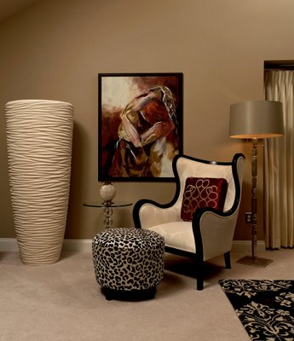
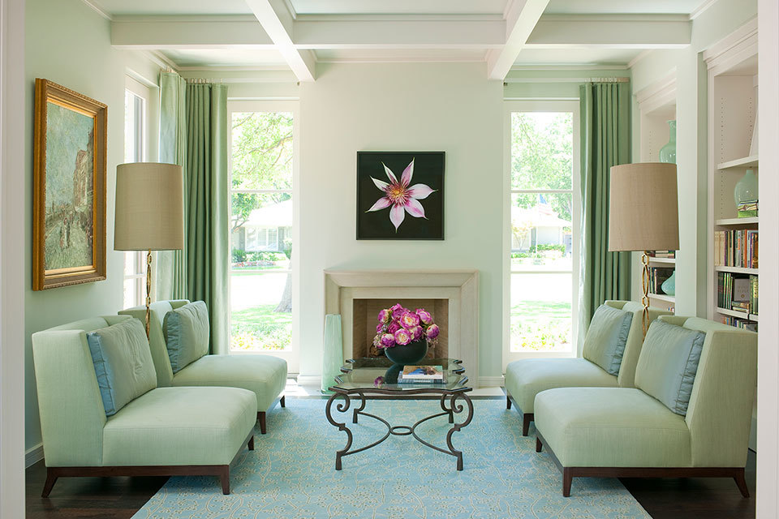
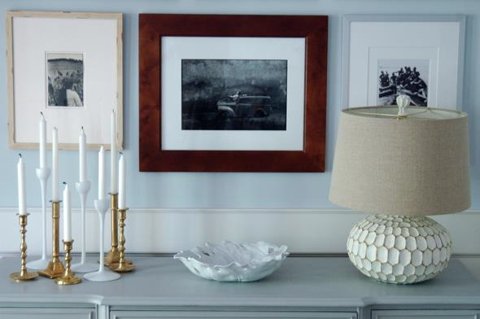
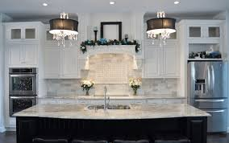
Symmetrical or Asymmetrical?

Slide 16
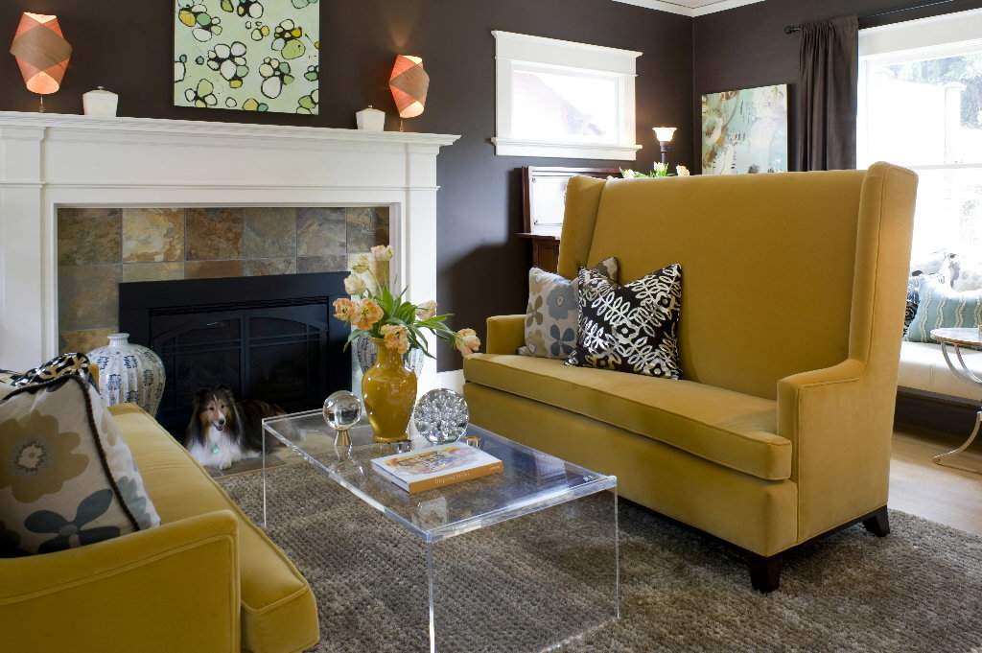
Rhythm
Definition: the principle that suggests connected movement between different parts of a design
Often referred to as continuity
Created with colors, lines, forms or textures
Can add interest to an area, but avoid overuse
Different types of rhythm:
Repetition
Radiation
Gradation
Opposition
Transition

Slide 17
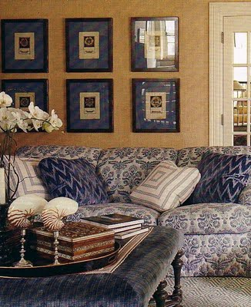
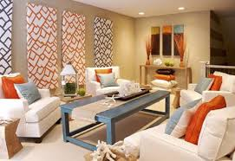
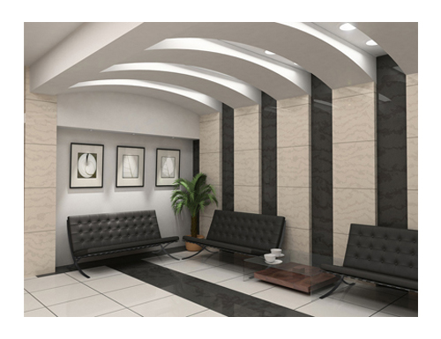
Rhythm
Repetition
The act of repeating
Helps lead eye from one point to another

Slide 18
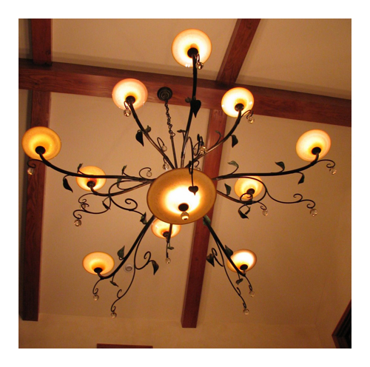
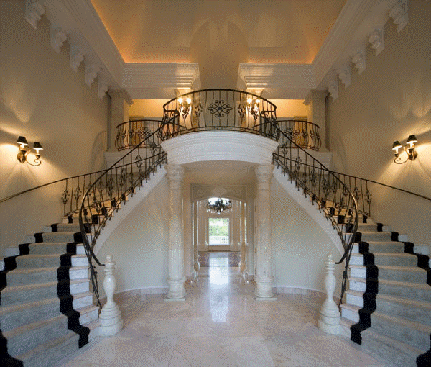
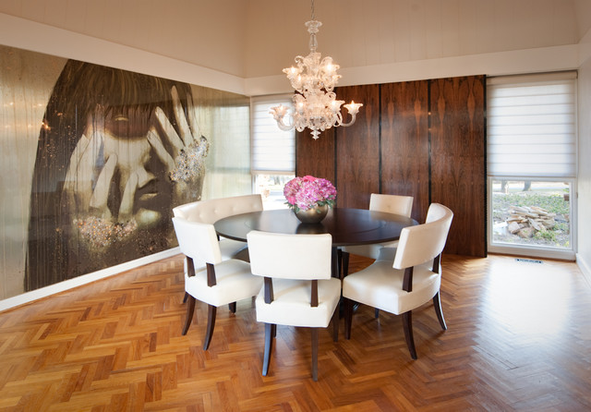
Rhythm
Radiation
Occurs when lines radiate, or move outward from a central point
Ex. Chairs around a table

Slide 19
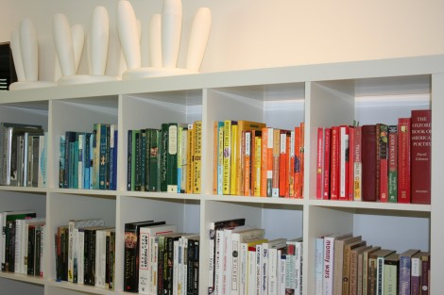
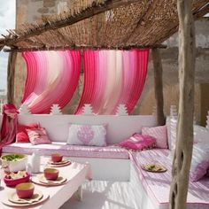
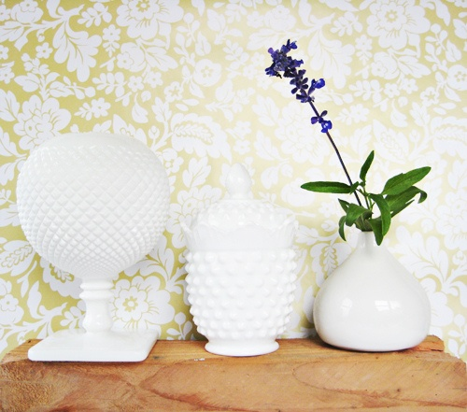
Rhythm
Gradation
A gradual increase or decrease in color, size, or pattern
Ex. Candles arranged from short to tall

Slide 20
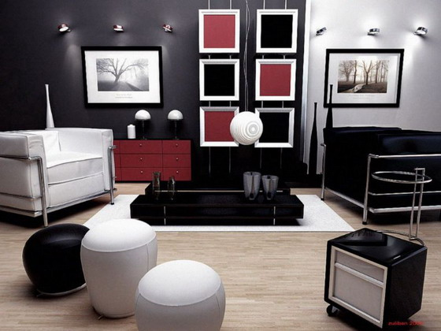
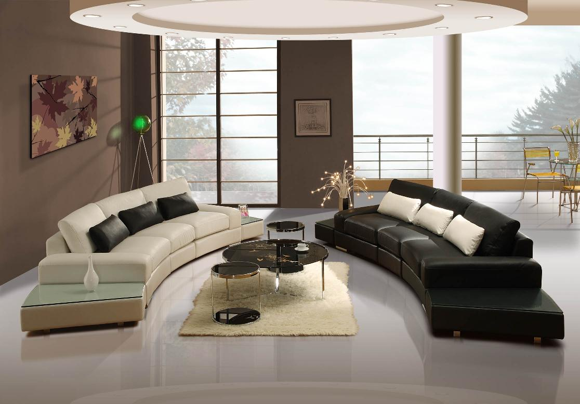
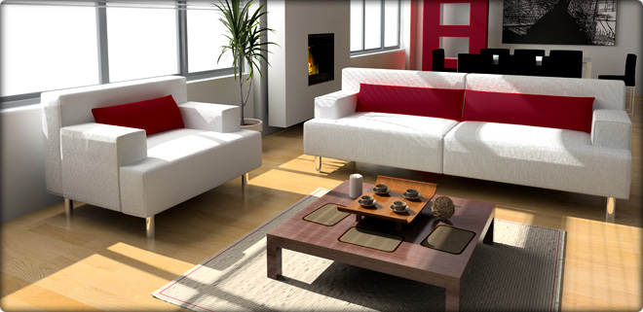
Rhythm
Opposition
When lines come together to form right angles.
Ex. Square doorways and curtains that hang straight down

Slide 21
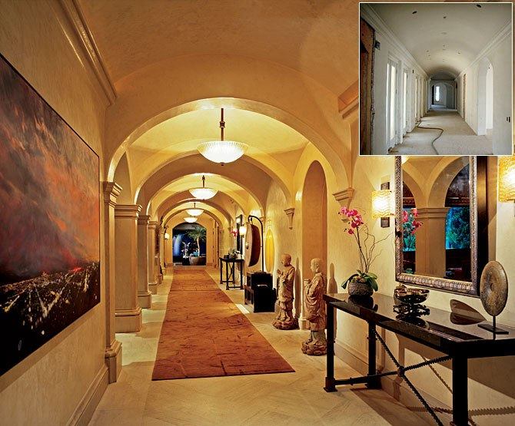
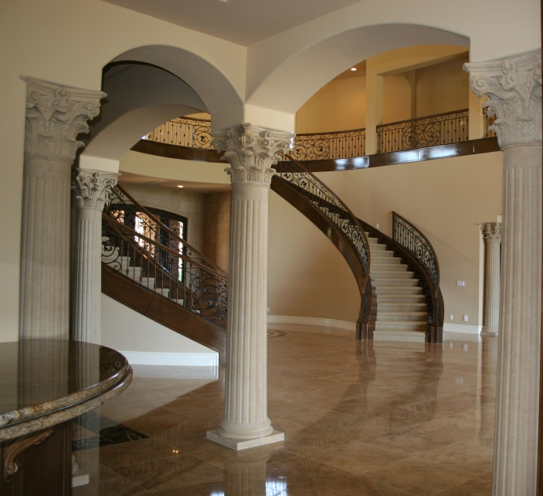
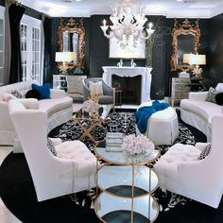
Rhythm
Transition
When lines change direction by flowing in a curve
When curved lines lead the eye from one object to another

Slide 22
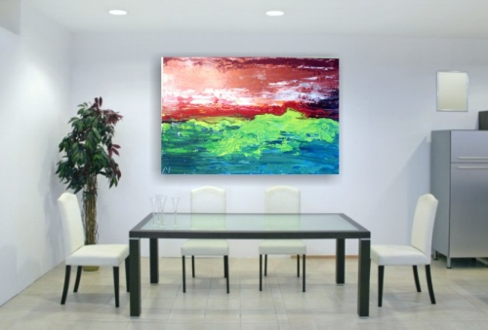
Emphasis
Definition: often called center of interest or focal point
Ex. Dramatic structural features:
Stained glass window
Winding stairs
Stone fireplace
Anything that draws attention

Slide 23
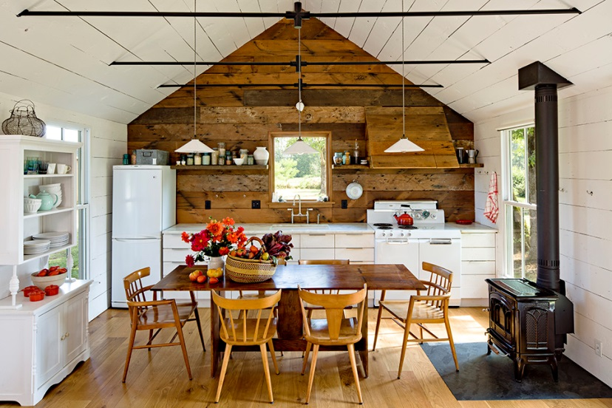
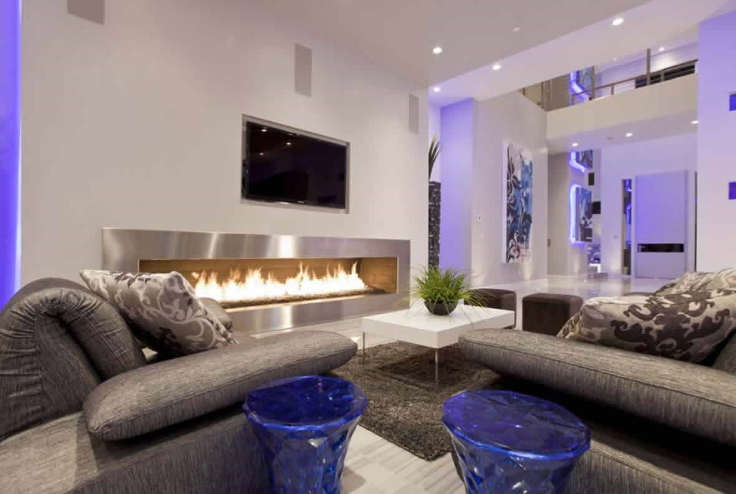
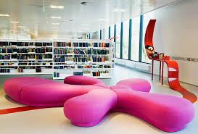
Emphasis
What is the emphasis in these photos?

Slide 24
Unity
Occurs when all the parts of a design are related by one idea.
The result is design harmony.
Choose items with similar characteristics
Ex. Furniture and accessories with curved lines.
Variety is important!!
Without it—monotonous and predictable
Eclectic style = mix of furnishings of different styles

Slide 25
Library
China

